Slide 1


Centennial Legacy Campaign
Legacy
Giving:
Making
a Lasting Impact

Slide 2
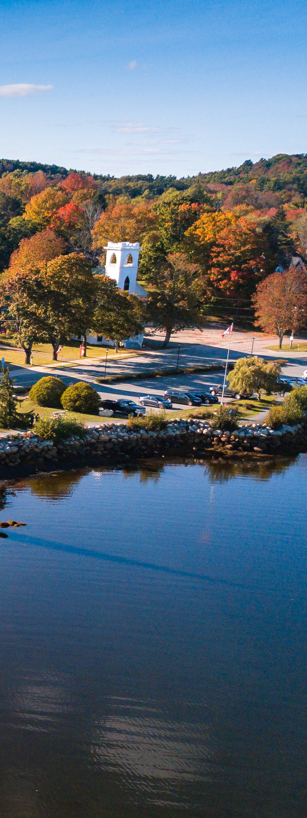
Why Legacy Giving Matters
Legacy gifts ensure the future of our church and its ministries
They enable us to continue vital programs and expand our impact
Legacy giving allows donors to leave a meaningful, lasting contribution to their faith and community
The United Church of Canada | The United Church of Canada Foundation
2

Slide 3
Types of Legacy Gifts
Bequests
A gift through a will
Securities and Stocks
Avoid capital gains tax while supporting their church
Life Insurance Policies
Name their church as a beneficiary
Cash or Endowments
Immediate impact with flexible usage
Retirement Accounts
Designate RRSPs, RRIFs, or TFSAs to their church
The United Church of Canada | The United Church of Canada Foundation
3

Slide 4
Tax Benefits of Legacy Giving
Receive a charitable tax receipt for your estate
Reduce taxable income and maximize the impact of your gift
Avoid capital gains taxes on gifts of securities or stocks
Ensure your gift supports the causes you care about most
The United Church of Canada | The United Church of Canada Foundation
4

Slide 5
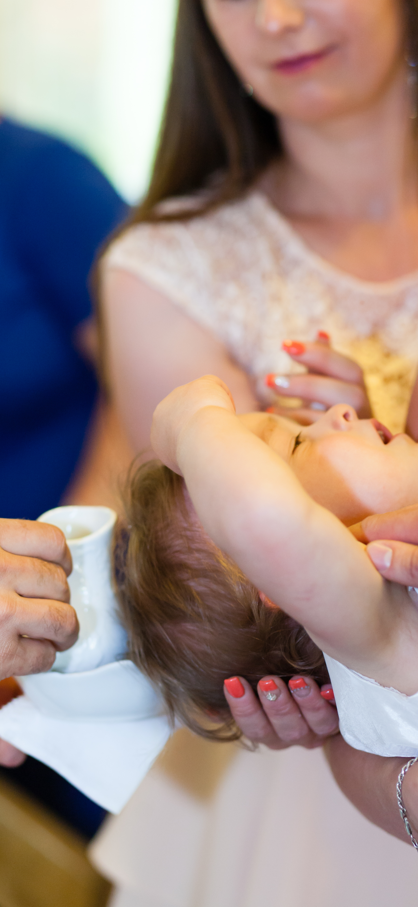
Flexible and Contingency Planning
If the specified program no longer exists, funds will support a similar purpose
Allows donors to ensure their legacy aligns with their values, even as needs change
Provides peace of mind for donors and their families
The United Church of Canada | The United Church of Canada Foundation
5

Slide 6

Recognizing Legacy Donors
Members of the legacy society are honored annually
Donors can choose to remain anonymous or be publicly acknowledged
Recognition events and plaques show gratitude and inspire others
The United Church of Canada | The United Church of Canada Foundation
6

Slide 7
How to Talk About Legacy Giving
Focus on
the impact:
'Your gift will ensure our church thrives for future generations'
Share success stories from
other donors
Be ready to
answer common questions and provide resources
Emphasize flexibility and
tax benefits
The United Church of Canada | The United Church of Canada Foundation
7

Slide 8

Next Steps
Reflect on how our church has impacted your life and community
Discuss with your family and financial advisors
Contact us for more information or to explore giving options:
Email: tamara@philanthropica.ca
The United Church of Canada | The United Church of Canada Foundation
8

Slide 9


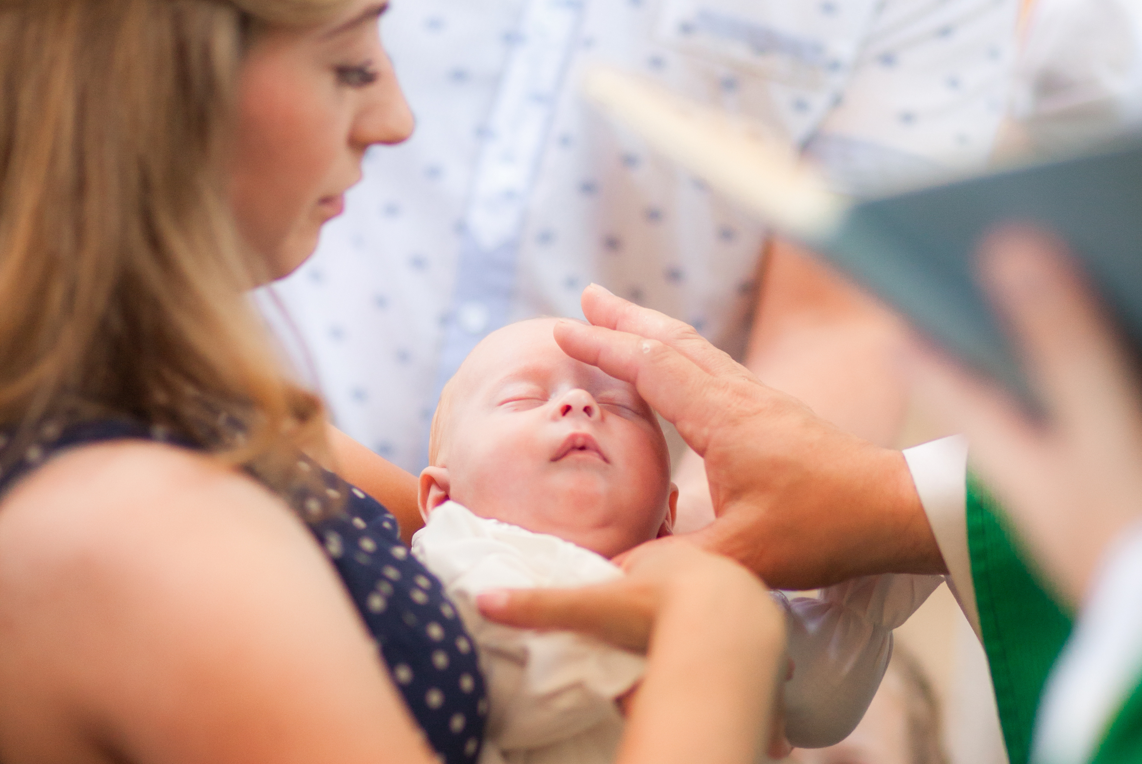
Thank you!
We appreciate your dedication and efforts to share the importance of legacy giving.
Together, we can secure the future of our church and its mission.

