Slide 1
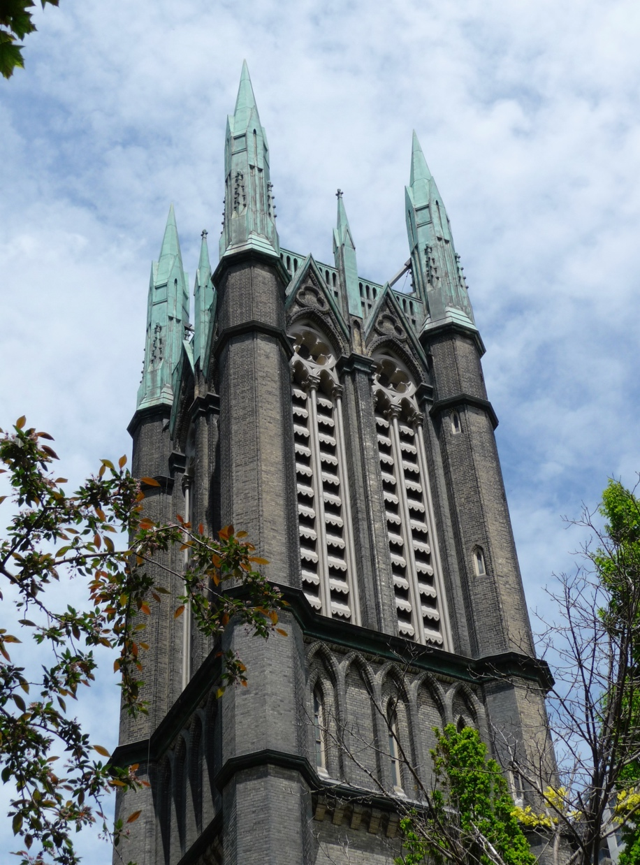

Here we are
<Name of United
Church>
Your church
Photo here
Today, tomorrow, and for the next 100 years.
Your legacy will be a bold and vibrant <Name of United Church> for the future!
Notes:
Add your church photo here

Slide 2

In Exodus, God calls Moses to lead the Israelites out of slavery.
In 1 Samuel, God calls to their young prophet in the night.
And in the Gospels, Jesus calls Mary Magdalene first to spread word of the Easter resurrection to his disciples and believers.
As Easter People, we know that God is also calling us: to carry out God’s work in our community, and to ensure that God’s faith and love flourishes.
Here we are... Together, let us answer God’s call.
Your legacy will be a bold and vibrant <Name of United Church> for the future!
Notes:
Read slide
Speaking note: This text is from the Case for Support. Simply reading the slide connects your audience to the Bible story.

Slide 3

Your legacy will be a bold and vibrant <Name of United Church> for the future!
Notes:
As you may know, this year The United Church of Canada celebrates its centennial. The Church is calling us to respond with deep spirituality, bold discipleship, and daring justice.

Slide 4
Centennial Legacy Campaign
The United Church of Canada Centennial Legacy Campaign invites congregations and members to take a leap of faith together.
It offers an opportunity to honour the The United Church of Canada’s history while building a secure foundation for its future.
Legacy gifts will ensure your church continues to thrive as a place of faith, community, and support for generations to come.
Will you do your best to ensure <Name Here> long-term sustainability and vibrant presence for the next century?
Your legacy will be a bold and vibrant <Name of United Church> for the future!
Notes:
Read slide

Slide 5
Centennial Legacy Campaign
<Name Here> is invited to celebrate 100 Years of The United Church of Canada
Encourage planned / legacy gifts from members of <Name Here> to ensure the success of your congregation for the next 100 years.
Public Phase: June 2025 - June 2028
Campaign Close: June 2028
Your legacy will be a bold and vibrant <Name of United Church> for the future!
Notes:
Read slide

Slide 6
Campaign Objectives
1. Support Local Congregations like
<Name Here>
Ensure local communities of faith thrive long-term
Use gifts for sustainable funding of programs, facility maintenance,
and general operations
Congregations decide how to allocate funds based
on their specific needs
2. Establish and sustain transformative programs throughout The United Church of Canada
Fund initiatives like youth leadership development, global partnerships, Indigenous church growth, and climate justice projects
Expand leadership education to equip ministry personnel and strengthen struggling congregations
3. Strengthen
The United Church of Canada Foundation
Create endowments for perpetual support
Enable donors to designate their funds for specific congregations, programs, or causes
Your legacy will be a bold and vibrant <Name of United Church> for the future!
Notes:
The legacy campaign has three primary objectives.
First and foremost, it is to support local congregations like y/ours.
The United Church of Canada wants very much to…
Read bullet points.
The other two objectives are less important but may prove very meaningful to some members of y/our congregation.
Objective two is to establish and sustained transformative programs throughout The United Church of Canada. After helping y/our local church, people in y/our congregation may wish to fund national initiatives or support the Mission and Service.
Read bullet points
And, finally, the third objective is to strengthen The United Church of Canada Foundation for the long-term welfare of our Church. I can speak more to this later, but for now let’s focus on y/our congregation.

Slide 7

What’s in it for <Name of United Church>?
1. Strengthen your ministries
Legacy gifts sustain essential ministries, allowing congregations like yours to nurture faith, healing,
and community on local, national, and global levels.
2. Create financial stability
By contributing to or establishing endowment funds, legacy gifts provide a dependable income stream, ensuring the ongoing support of congregational programs and operations indefinitely.
3. Expand transformational programs
Legacy gifts enable congregations like yours to develop innovative programs that address evolving community needs, fostering spiritual growth and engagement.
Your legacy will be a bold and vibrant <Name of United Church> for the future!
Notes:
What’s in it for church name?
There are nine great reasons that y/our church should participate in the Centennial Legacy Campaign.
Read bullet points 1-3

Slide 8

What’s in it for <Name of United Church>?
4. Enhance facilities and infrastructure
Legacy gifts can be used to maintain, repair, or upgrade your church building, ensuring the facility remains safe, accessible, and welcoming for all members.
5. Provide stability during transitions
Legacy funds act as a financial safety net, helping congregations like yours navigate leadership changes, economic uncertainties, or unexpected challenges.
6. Foster long-term growth
Even modest contributions can grow over time, creating resources that transform and sustain congregational life and activities.
Your legacy will be a bold and vibrant <Name of United Church> for the future!
Notes:
Read bullet points 4-6

Slide 9

What’s in it for <Name of United Church>?
7. Encourage a culture of giving
Legacy giving inspires others to make similar commitments, fostering a tradition of generosity
and long-term support within your congregation.
8. Build stronger community bonds
By collectively supporting your congregation through legacy gifts, members strengthen connections, fostering unity and a shared vision for the future.
9. Secure the future for generations
Legacy giving ensures that congregations like yours remain vibrant, impactful, and relevant, continuing to provide a spiritual and faith home for future generations.
Your legacy will be a bold and vibrant <Name of United Church> for the future!
Notes:
Read bullet points 7-9

Slide 10
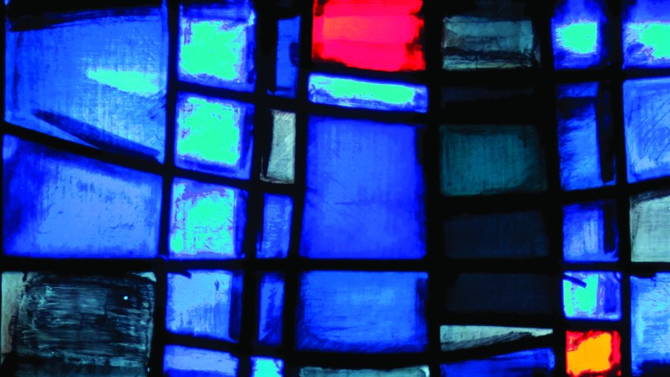
Resources
Your legacy will be a bold and vibrant <Name of United Church> for the future!
Notes:
Now that I’ve piqued your interest in how the legacy campaign can benefit y/our church, you’re probably wondering how – given all of y/our other responsibilities and priorities – how are you going to launch this initiative?
The good news is that The United Church of Canada is providing us with ready-to-use resources that are accessible anyone and everyone 24-7.

Slide 11
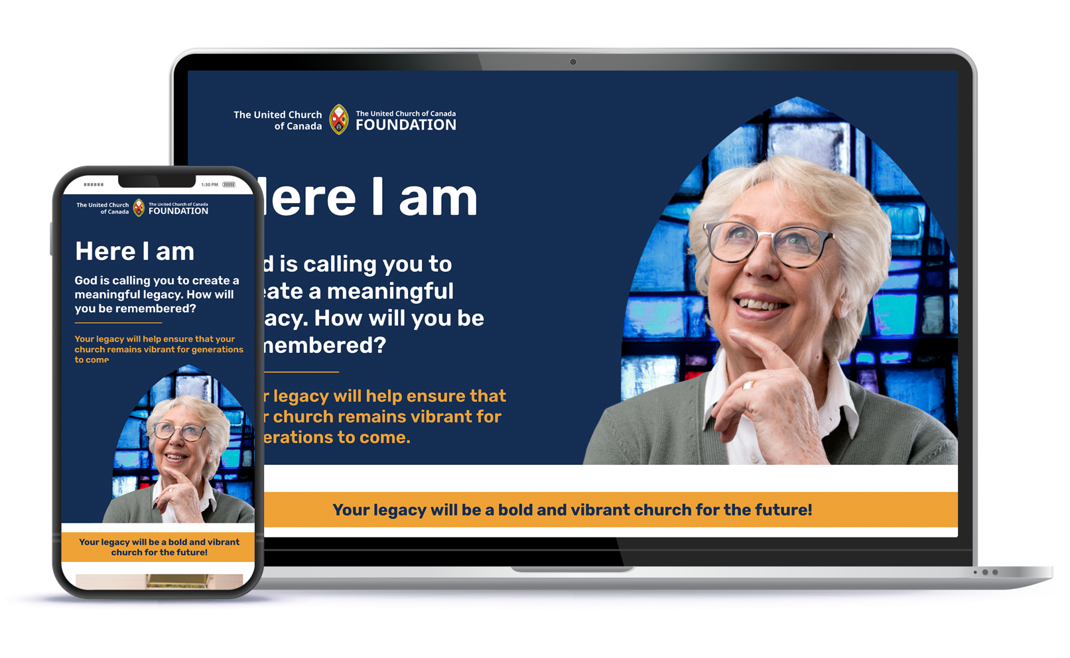
centennialcampaign.ca
Your legacy will be a bold and vibrant <Name of United Church> for the future!
Notes:
Everything you need you can access now through the campaign website: centennialcampaign.ca

Slide 12
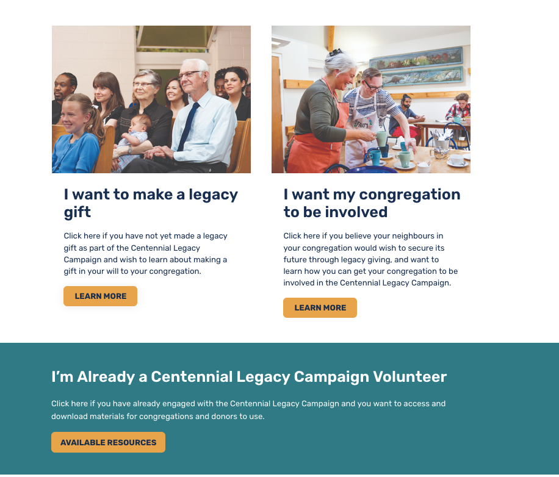
Website Key Features
Donors
Congregations
Volunteers
Your legacy will be a bold and vibrant <Name of United Church> for the future!
Notes:
When you come to the homepage under the picture of the woman, you will find three options: a section for donors; a section for congregations; and a section for volunteers like me.

Slide 13
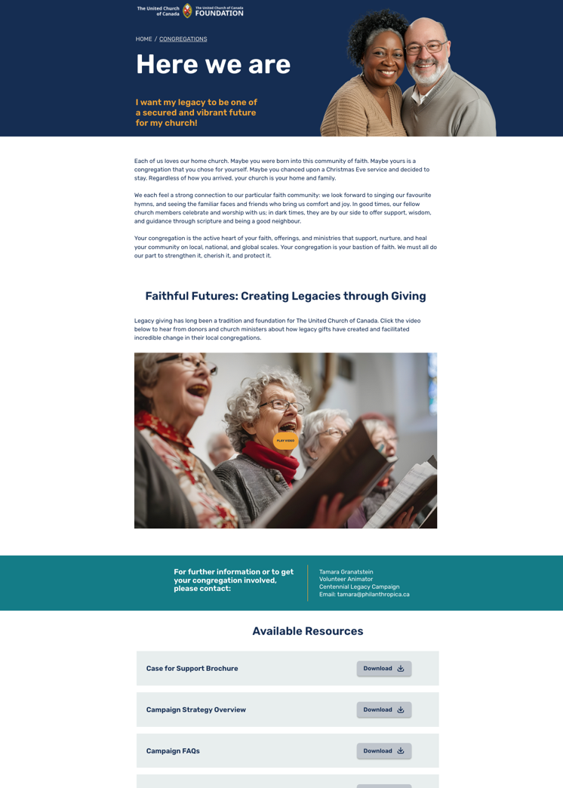
Website: Congregation
Page
Introductory Video
Resources
Your legacy will be a bold and vibrant <Name of United Church> for the future!
Notes:
Clicking on “Congregations,” you will see a great introductory video that I encourage you to watch. You can also share this short, 3-1/2 minute video with your congregation.
Scroll down and you’ll see resources that you can download at the click of a button.
As the campaign unfolds, more and more resources will be added to the website.

Slide 14
Invaluable Congregational Resources
Your legacy will be a bold and vibrant <Name of United Church> for the future!
Notes:
There’s a Case for Support… fact sheets… as well as an Endowment Guidebook that helps church leaders like yourself launch a campaign with simple, step-by-step instructions.

Slide 15
Case for support
Everything people need to know is in one brochure
Download document or order printed copies for Trustees or your Official Board
Your legacy will be a bold and vibrant <Name of United Church> for the future!
Notes:
The Case for Support is a 4-page brochure you can download. You can also order printed copies.

Slide 16
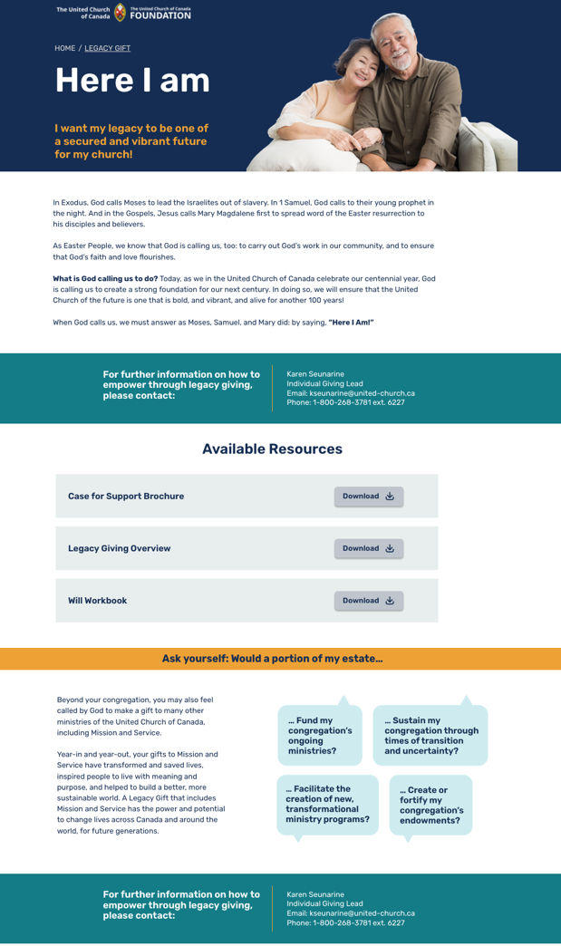
Website:
Donor Page
Resources
Contact person
Your legacy will be a bold and vibrant <Name of United Church> for the future!
Notes:
Clicking on “Donors,” you will see resources and, at the bottom of the page, information about who to contact for more information.

Slide 17
Helpful Donor Resources
Your legacy will be a bold and vibrant <Name of United Church> for the future!
Notes:
For now, helpful donor resources include the Case for Support; a Legacy brochure, and an absolutely fabulous Will Workbook that helps any perspective donor plan their estate before they meet with their lawyer or financial planner. I can’t recommend this resource highly enough. It’s fabulous!

Slide 18
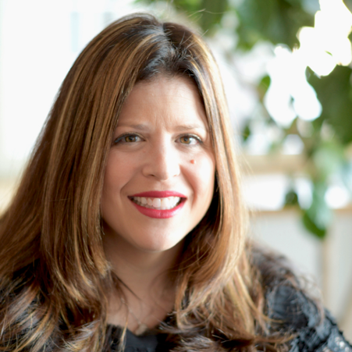
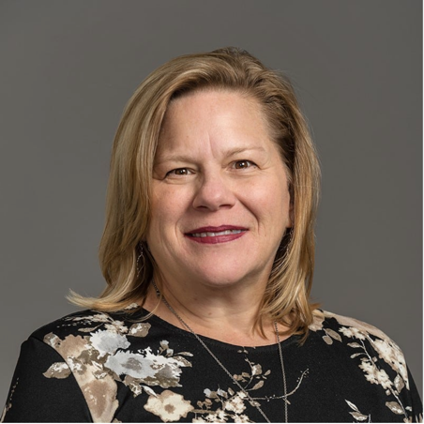
Knowledgeable Experts
Congregations
Tamara Granatstein
514-244-0705
tamara@philanthropica.ca
Donors
Karen Seunarine
1-800-268-3781 ext. 6227
kseunarine@united-church.ca
Your legacy will be a bold and vibrant <Name of United Church> for the future!
Notes:
Here, you see contacts for two knowledgeable experts who are ready to help. You don’t need to write down their contact information now, it’s on the website.

Slide 19
Again, what’s in it for <Name here>?
1. Strengthen your ministries
2. Create financial stability
3. Expand transformational programs
4. Enhance facilities and infrastructure
5. Provide stability during transitions
6. Foster long-term growth
7. Encourage a culture of giving
8. Build stronger community bonds
9. Secure the future for generations
Your legacy will be a bold and vibrant <Name of United Church> for the future!
Notes:
So, let’s remind ourselves of why we’re here, of what’s in it for us?
Read slide quickly

Slide 20
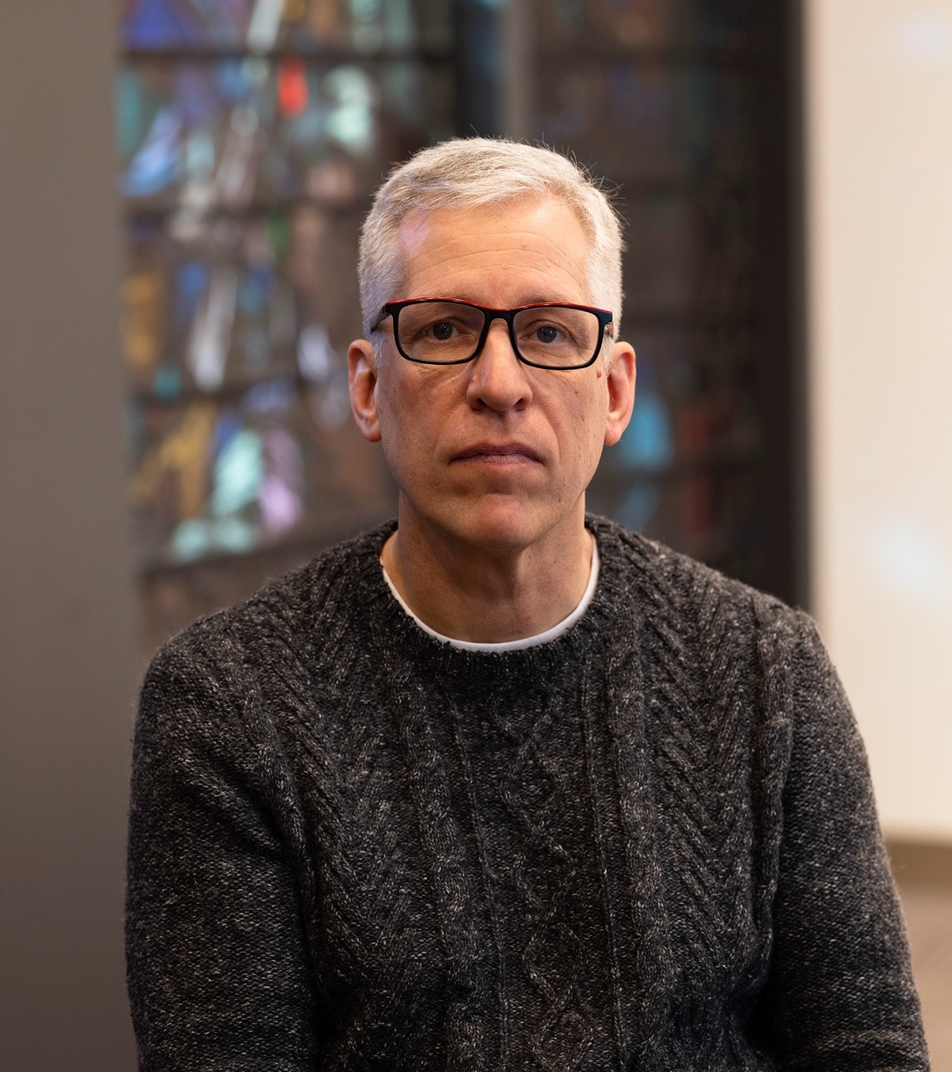
Why I’m leaving a
Legacy
Your photo here
Your legacy will be a bold and vibrant <Name of United Church> for the future!
Notes:
Design Note: Add your photo here.
Speaker Note: If you have left a legacy gift to your congregation (even if it’s not the one you’re presenting to), now is the time to tell people. Your story will inspire them to think seriously about writing or updating their Will to include their church.

Slide 21
Here I am
Volunteer Name:
Email or Phone:
Your photo here
I’m here to help you plan
for the next 100 years!
Your legacy will be a bold and vibrant <Name of United Church> for the future!
Notes:
Design Note: Upon completion, have your name email or phone number up for as long as possible. While you answer questions, people will likely write this information down and email or call you afterwards. This is the best part: having the opportunity to have people share with you their hopes and dreams for their congregation for today, tomorrow, and for the next 100 years.

