Slide 1
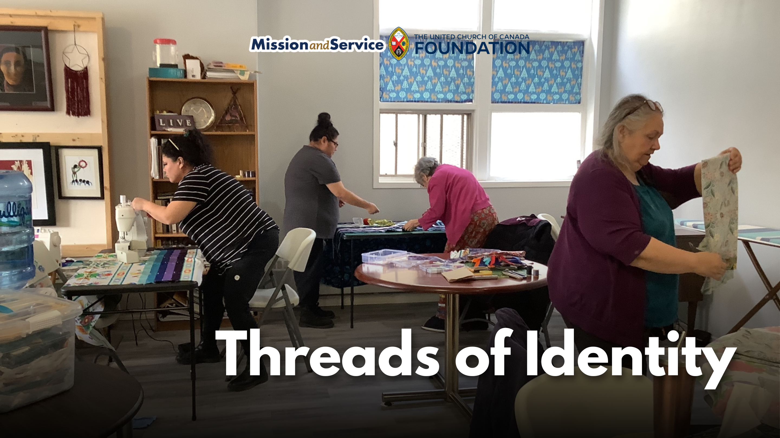

Slide 2
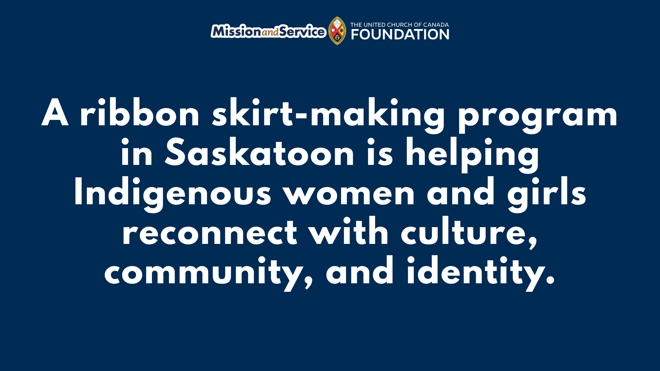
Notes:
In Saskatoon, Saskatchewan, Mamohkamatowin Spiritual Community Inc. is helping Indigenous people reconnect with culture and community through a ribbon skirt-making program. Supported by Mission and Service, the program provides Indigenous participants living in Saskatoon’s core neighbourhoods with the materials, tools, and teachings needed to create their own ribbon skirts at no cost.
For many Indigenous women and girls, a ribbon skirt is more than a garment. It is an expression of identity, culture, and belonging, worn during ceremonies, celebrations, and other cultural and spiritual gatherings. For people living on low incomes, the cost of making or purchasing a ribbon skirt can place that expression of identity out of reach.
Participants learn how to use a sewing machine while making a skirt that reflects their own style and story. Alongside the practical sewing skills, they also receive teachings from an Elder, creating opportunities to deepen their understanding of the cultural and spiritual significance of ribbon skirts.
With support from Mission and Service, the program first started in 2024. Since then, community support has made it possible to purchase sewing machines and tables so participants have the tools they need to learn. Our support through Mission and Service helps provide fabric, ribbon, and other materials for each skirt, ensuring that cost to participants does not become a barrier.
The impact has been evident and ongoing. The women who completed the first sessions wear their ribbon skirts with great pride, knowing they had made them with their own hands while learning traditional teachings and connecting with community.
Programs like this reflect our commitment to supporting Indigenous leadership, strengthening community, and creating opportunities for people to reconnect with culture in meaningful ways. By combining practical skills with cultural teachings, Mamohkamatowin Spiritual Community Inc. is helping participants build confidence, celebrate their identities, and carry their traditions forward.
Our gifts through Mission and Service help support Indigenous-led ministries and community programs like this one. Together, we can help ensure more people have opportunities to learn, connect with culture, and participate fully in the traditions and communities that are meaningful to them. Let’s give generously.

