Slide 1
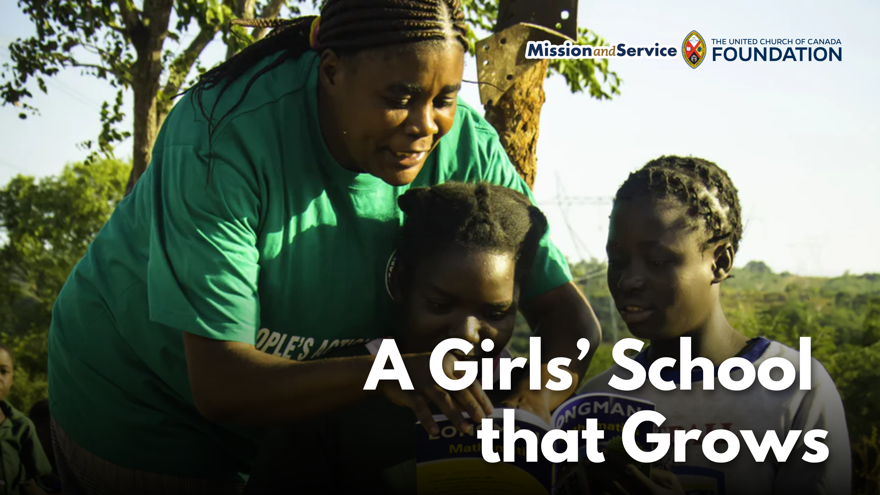

Slide 2
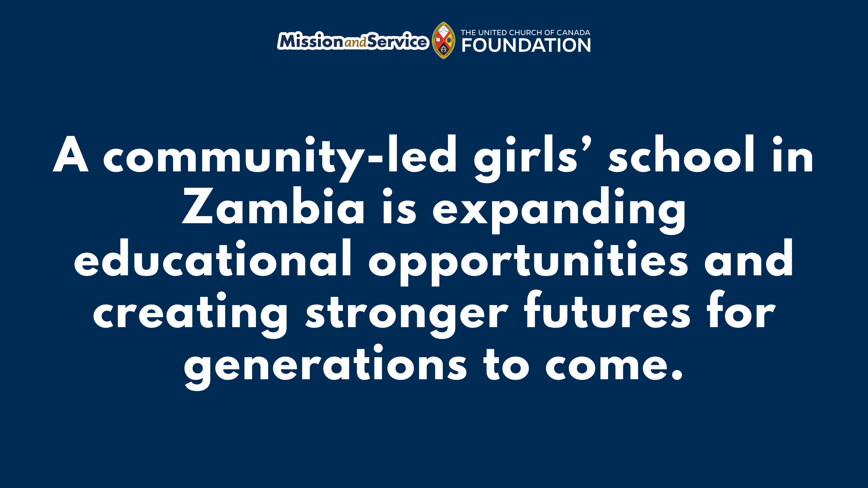
Notes:
In Zambia, People’s Action Forum (PAF) has been supporting girls’ education through its Girls’ Action Forum program. Through our ongoing support of Mission and Service, we are part of a partnership that helps girls stay in school, access mentorship, and build pathways toward a brighter future. This work is now growing through the development of a new girls’ school in Shimabala, Zambia.
For many girls in the area, completing their education can be a challenge. When girls begin menstruating, become pregnant, marry, or are needed at home to support their families, they may be forced to leave school. Without access to continued education, these girls will face fewer opportunities and a heightened risk of lifelong poverty.
Since 2014, PAF’s Girls’ Action Forum has worked to support girls, particularly those from rural communities, by helping them remain in school or return to continue their education. Through mentorship and encouragement, the program has helped girls recognize their potential and continue pursuing their goals.
Building on this important work, PAF is developing a girls’ school that will provide education and scholarships for students from rural communities. The school is being developed on two hectares of land in Shimabala. The long-term vision is for a comprehensive girls’ school that will eventually grow to include secondary education and boarding facilities.
As part of creating a sustainable future for this project, PAF has started agricultural activities on the land to help generate income that supports the organization’s ongoing work. The project has established a water system, built caretaker lodging, and joined a local farming cooperative to increase opportunities for sustainable income.
The school’s growth will happen in stages. It began by serving younger children through nursery and kindergarten programs, with plans to expand to include preschool and eventually secondary education. Each step brings PAF closer to creating a learning environment where girls can access education regardless of their circumstances.
Through our gifts to Mission and Service, we support long-term partnerships that create lasting opportunities for communities around the world. Together with organizations like PAF, we help nurture education, leadership, and hope for the next generation.
Our gifts help sustain partnerships that support education and create opportunities for girls and young people around the world. Together, we can help ensure that more girls have the chance to learn, grow, and shape their own futures. Let’s give generously.

