Slide 1
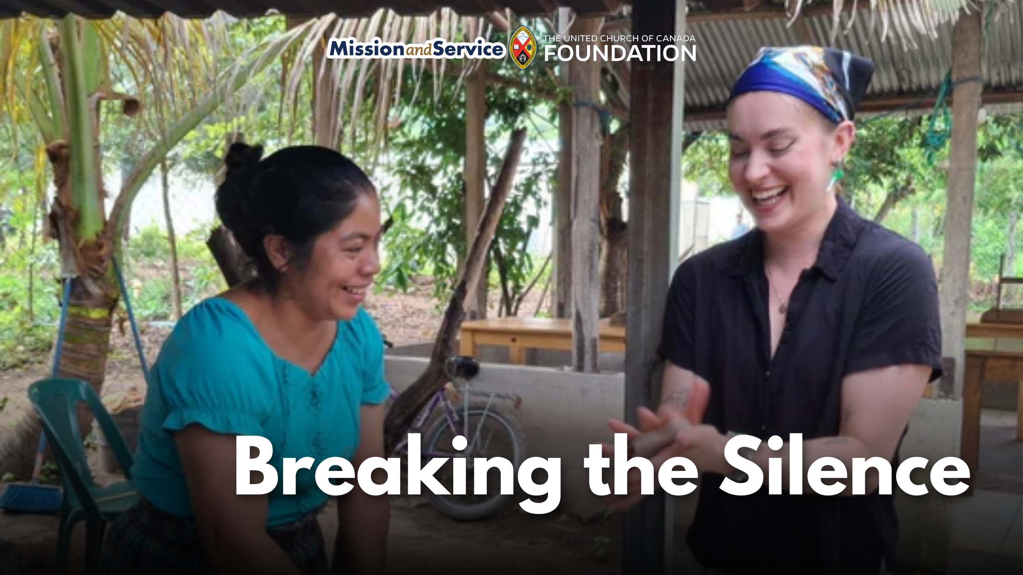

Slide 2
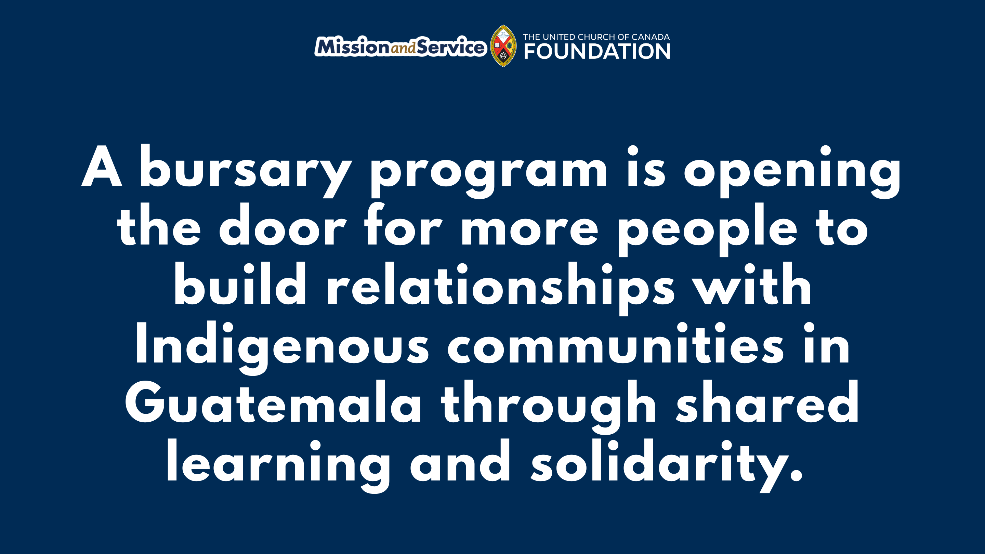
Notes:
In Guatemala, Maya and Xinka Indigenous people continue to rebuild their communities after the genocide of the 1980s, while still facing violence and repression by the Guatemalan government. Breaking the Silence (BTS) in Nova Scotia works with Maya and Xinka partners to provide opportunities to join human rights delegations and placements in Guatemala. There are many Maritimers who deeply identify with these struggles and challenges but can’t afford to participate in these opportunities.
This fall, a Mi’kmaq couple will travel to Guatemala with Breaking the Silence Network, where they will meet community leaders working to advance food sovereignty. At home, the couple are already making a difference by supporting community gardens and teaching traditional Mi’kmaq skills. In Guatemala, they will learn from Indigenous partners whose work reflects many of the same values: cultivating the land, preserving culture, and ensuring communities can nourish themselves for generations to come.
The experience will be one of mutual learning. Knowledge, stories, and practices will be shared across cultures, strengthening relationships that are rooted in respect and solidarity.
For this couple, however, the opportunity almost couldn’t happen.
The rising cost of international travel places these life-changing experiences beyond the reach of many people. Breaking the Silence created the bursary program to remove financial barriers that prevent people from participating in human rights delegations or volunteer placements. The bursaries are specifically intended to support low-income participants and members of Black, Indigenous, and other racialized communities who might otherwise be unable to take part.
The need for these delegations comes directly from Breaking the Silence’s Guatemalan partners. They regularly invite Canadians to visit their communities as companions. These visits offer encouragement, strengthen international relationships, and provide support for local human rights and community development initiatives. The presence of international partners can also offer a measure of protection for communities advocating for justice.
Through the bursary program, this couple will join the work of accompaniment while bringing home new ideas and renewed inspiration for their own ministry and community leadership. Their experience will not end when they return to Canada. The relationships they build and the lessons they learn will continue to ripple outward through the people they teach, the gardens they nurture, and the communities they serve.
Through Mission and Service, we support ministries that build relationships rooted in justice, dignity, and mutual learning. Together, we are helping remove barriers so that more people can answer the call to stand alongside partners around the world. Let’s give generously to ensure these connections remain possible. Connections that strengthen communities both near and far as we learn from one another and work together for a more just world.

