Slide 1
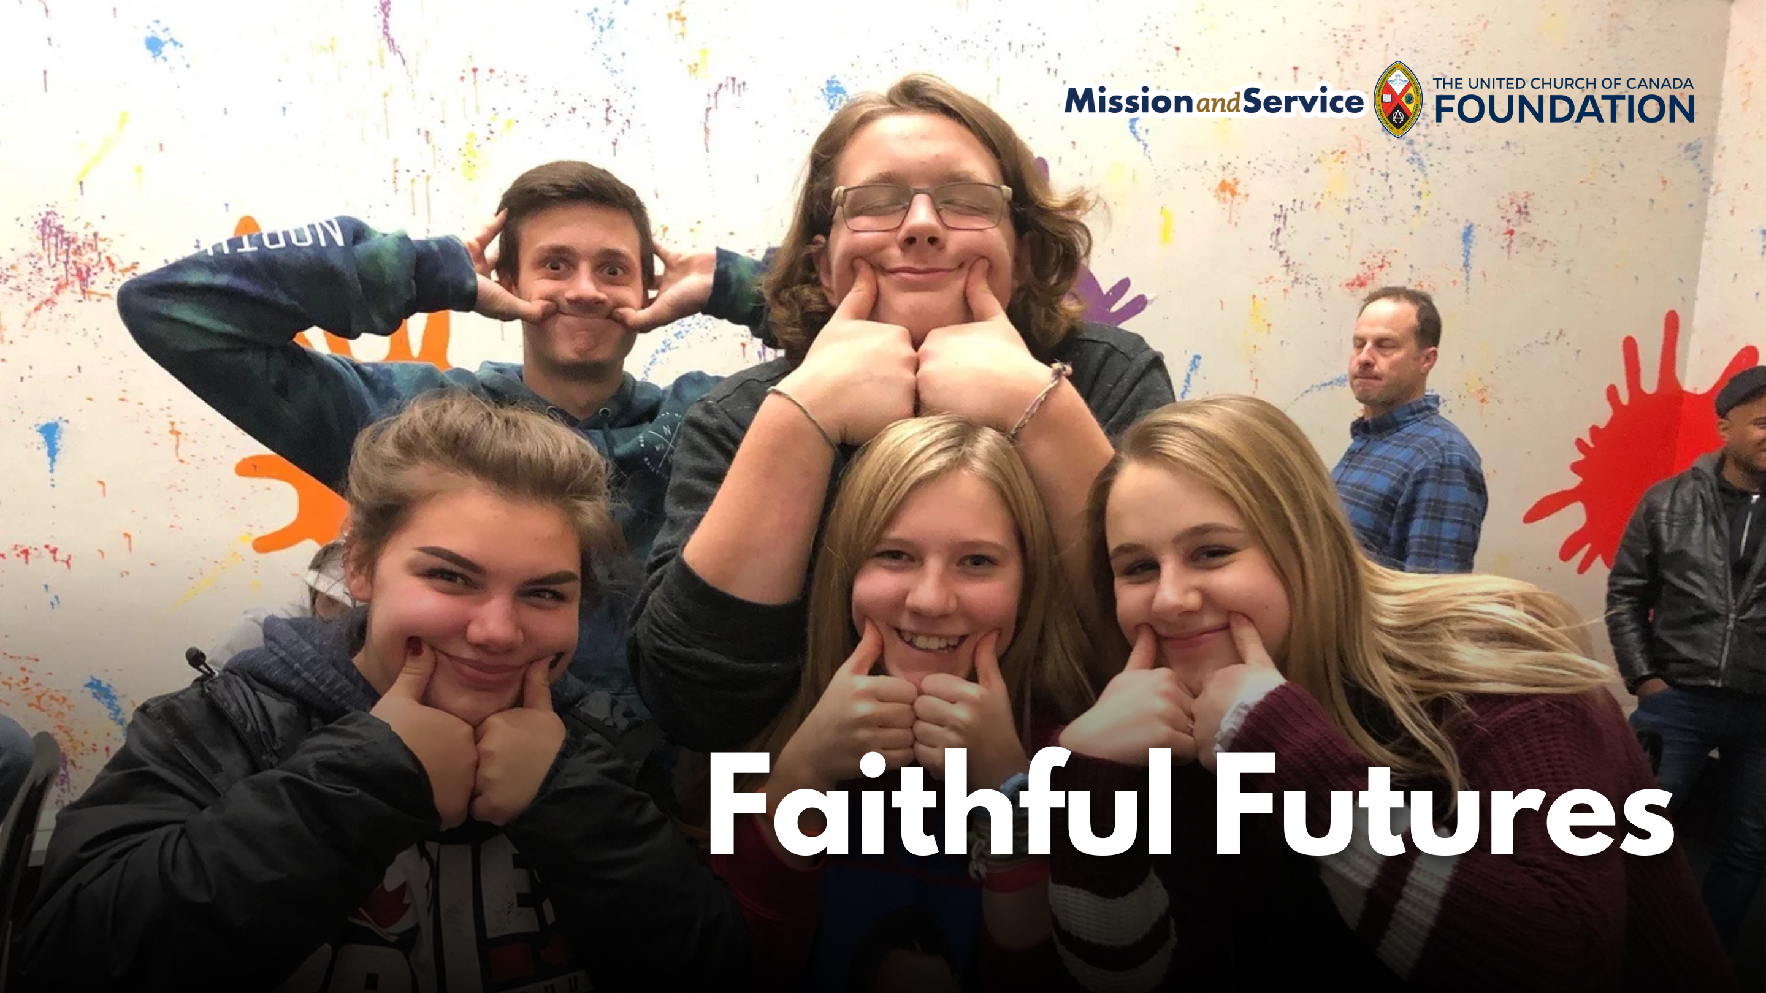

Slide 2
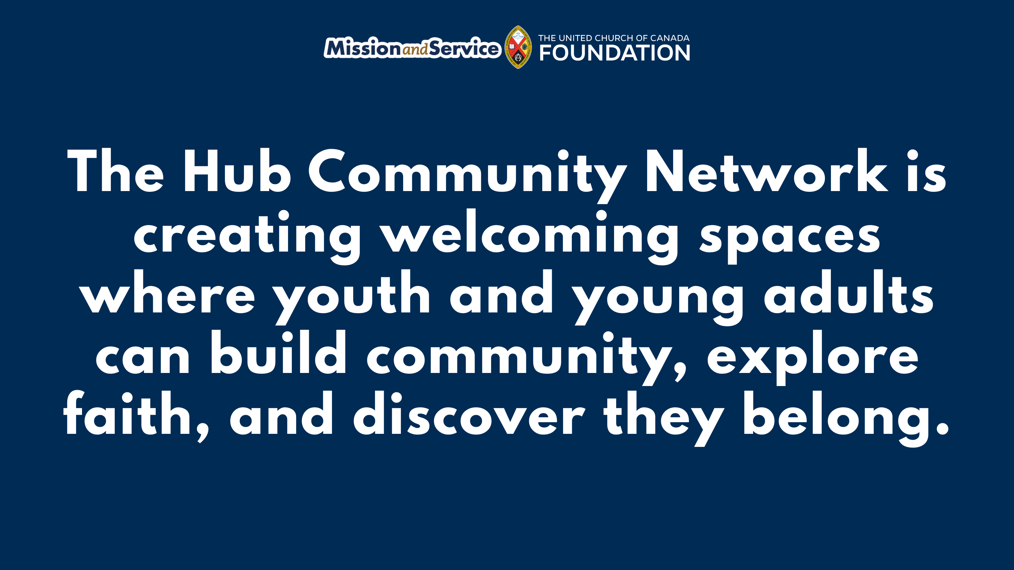
Notes:
Across Southern Ontario, The Hub Community Network is creating welcoming spaces where youth and young adults can find connection, community, and a deeper understanding of God’s inclusive love. Supported by Mission and Service, The Hub is helping young people discover spaces where they can explore faith, build relationships, and find their place in the church.
Every generation faces its own challenges, and many young people today are carrying significant pressures. Rising costs, uncertainty about the future, and increased feelings of isolation can make it difficult to find a sense of stability and belonging. For many youth and young adults, finding a community where they feel welcomed, known, and accepted can make a meaningful difference.
The Hub responds to this need by creating opportunities for young people to gather and connect. Through churches, camps, small groups, worship services, and online spaces, The Hub brings youth and young adults together in environments where they can ask questions, share experiences, and grow in faith alongside others.
These gatherings are more than events on a calendar. A shared meal, a conversation with a mentor, or time spent with peers can become an important moment of connection. These relationships help young people feel supported as they navigate life’s challenges and continue discovering who they are and who they are becoming.
The Hub also works alongside congregations, helping churches strengthen their youth ministries and develop lasting relationships with young people. By supporting communities in creating spaces of welcome and inclusion, The Hub helps congregations move beyond the initial invitation to attend, and grow toward building meaningful connections where young people know they belong.
Our Mission and Service gifts help make this ministry possible. Through this support, The Hub Community Network can continue creating spaces where youth and young adults experience community, explore faith, and encounter the inclusive love of God.
Our gifts through Mission and Service support ministries that walk alongside young people and create places of belonging. Let’s give generously so youth and young adults can continue being welcomed into spaces of connection and community.

