Slide 1


Slide 2
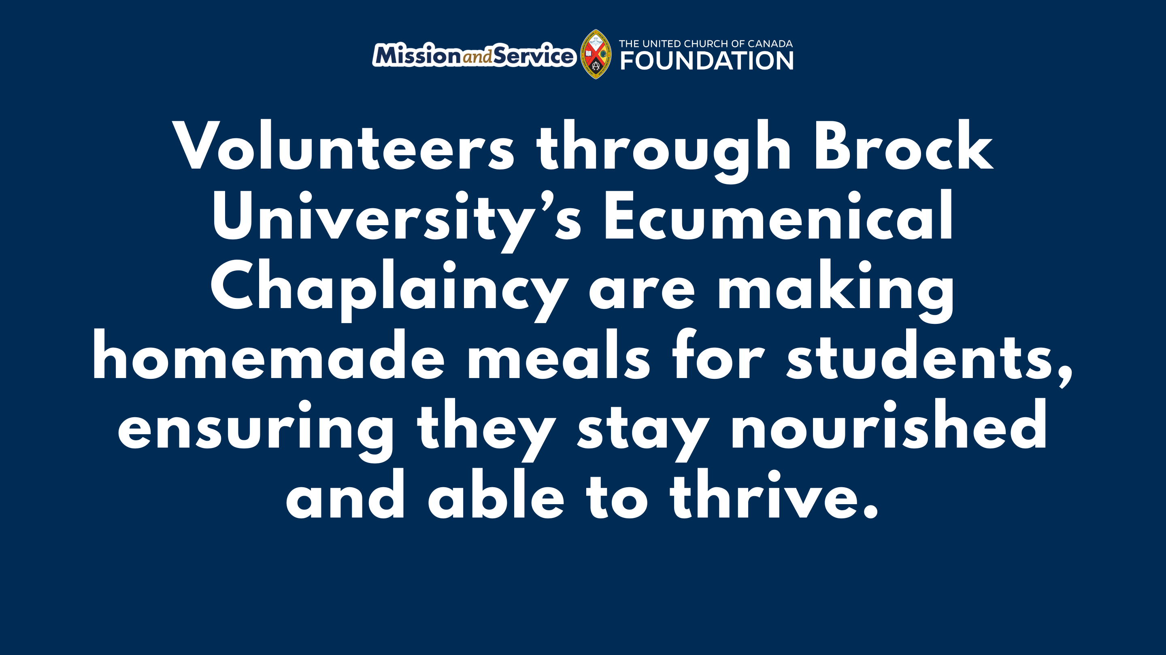
Notes:
At Brock University in St. Catharines, Ontario, the Ecumenical Chaplaincy is responded to student food insecurity with a practical ministry of care. Supported by Mission and Service, local church volunteers prepare homemade meals that are stored in freezers at the Faith and Life Centre. The ecumenical chaplain distributes the meals to students who ask for them, ensuring nutritious food is available when it’s needed.
As students prepare to return to campus for a new academic year, many are looking forward to new classes, new friendships, and new opportunities. For some, however, the start of the semester also brings financial pressure as they balance tuition, rent, textbooks, and rising grocery costs.
All these added and rising costs mean many students have little left in their budgets after paying for essentials. For some, skipping meals or relying on inexpensive, less nutritious food becomes part of getting through the semester.
The homemade meal program helps fill that gap. Volunteers cook meals in their own kitchens, package them in take-away containers, and replenish the freezer throughout the year. Their commitment means students can access nourishing food when they need it, helping ease one of the many pressures that can come with university life.
A homemade meal doesn’t solve every challenge a student faces, but it makes a meaningful difference. Good nutrition helps students concentrate, engage in their studies, and make the most of the opportunities that are presented to them.
We are helping sustain this work through Mission and Service, by supporting the cost of ingredients and containers, making it possible for volunteers to continue preparing meals for students experiencing food insecurity. Together, congregations, volunteers, and the chaplaincy are responding to the growing need with practical care.
As another school year begins, this ministry reminds us that care takes many forms. Sometimes it looks like a listening ear. Sometimes it’s a place to belong. And sometimes it’s a homemade meal waiting in the freezer.
As students return to campus, our gifts to Mission and Service help ministries like Brock University’s Ecumenical Chaplaincy provide practical support when it’s needed most. Together, we can help ensure students have access to nutritious meals and a caring community throughout the academic year. Let’s give generously.

