Slide 1
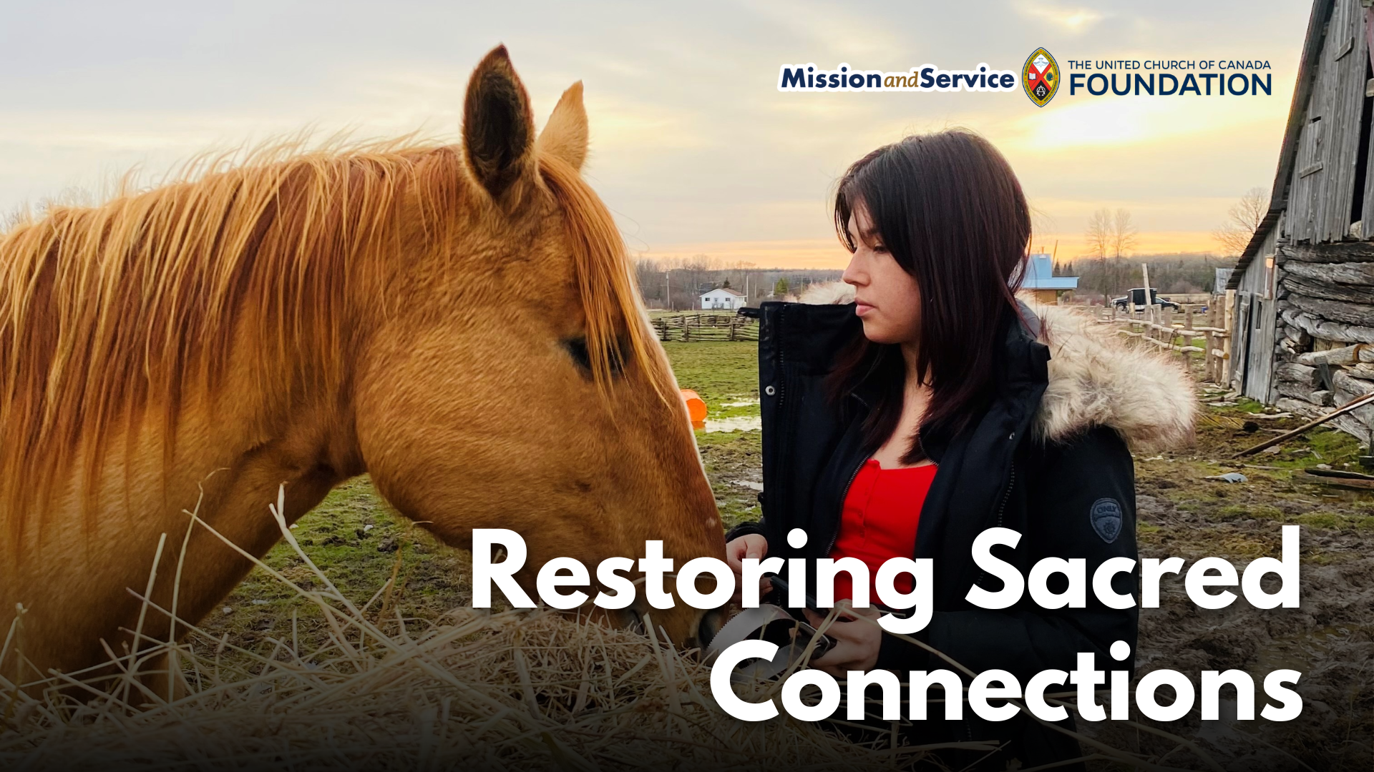

Slide 2
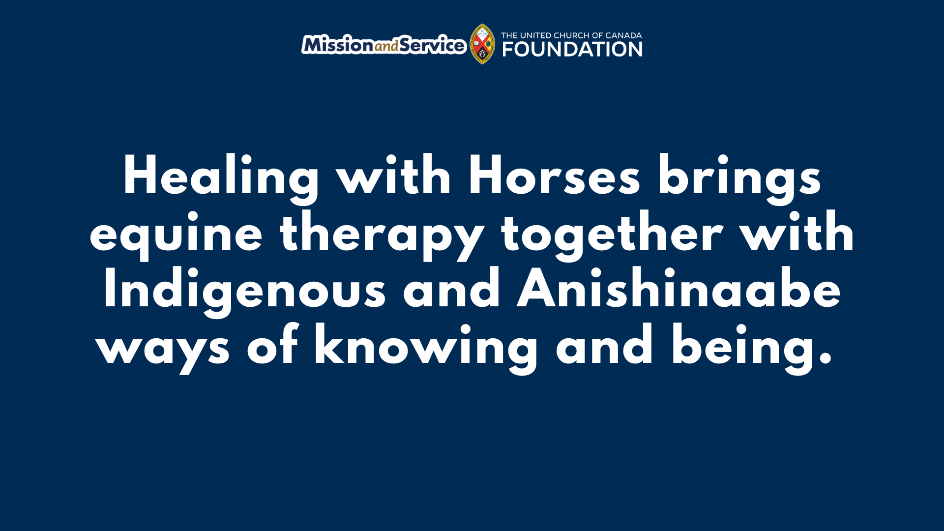
Notes:
In Wiikwemkoong Unceded Territory, healing happens in many forms. The Healing with Horses program brings people together to connect with one another, the land, and the gentle and powerful strength of horses. Among them are four Ojibwe Spirit Horses, a rare and sacred breed with a powerful connection to the community. Their story is one of survival and return.
At one point in history, the Ojibwe Spirit Horses were stolen from the community. Their return to the land and the people who have always known and cherished them is an act of resilience and reconciliation. Today, their presence offers a living reminder that what has been disrupted can be restored, and that healing can begin with reconnecting to what has been lost.
That spirit is at the heart of Healing with Horses. Supported by our Mission and Service gifts, the program brings equine therapy together with Indigenous and Anishinaabe ways of knowing and being. Traditional teachings, the Medicine Wheel, and the importance of relationships create a foundation for emotional, spiritual, and cultural healing.
Over the winter, participants ride through the snowy bush, sketched horses outdoors, and learned about emotional regulation, boundaries, and self-compassion. Some walked beside the horses or brushed their coats. Others gathered in circle and found a place to listen and be heard.
For some participants, sharing feelings was difficult. Through the program, they began to find their voices. Children learned ways to understand and manage their emotions, adults reconnected with their inner strength, and together, participants discovered that healing doesn't have to happen alone.
The horses help create that space. Their calming presence invites people to slow down, pay attention, and connect in a different way.
There's growing interest in expanding Healing with Horses so more people can take part throughout the year. Plans for a barn or indoor structure would allow this work to continue in every season.
Our Mission and Service gifts help make this possible. Our gifts support Indigenous-led programs that create opportunities for cultural reconnection, community, and healing. The Ojibwe Spirit Horses have found their way home. Through Healing with Horses, they are helping others find their way, too. Let's give generously.

