Slide 1
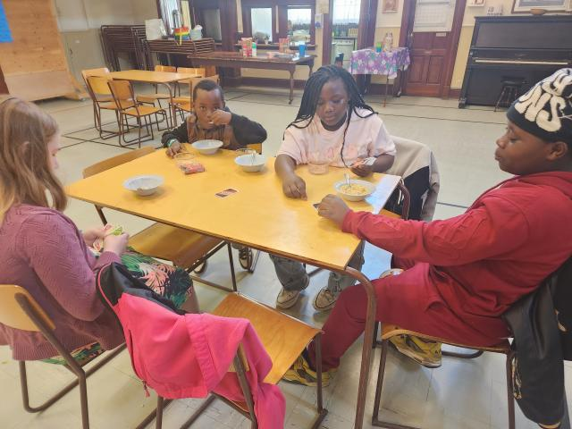


Breakfast Club

Slide 2

At Plymouth-Trinity United Church, the weekly breakfast program helps families and community members feel welcome and connected before worship.

