Slide 1
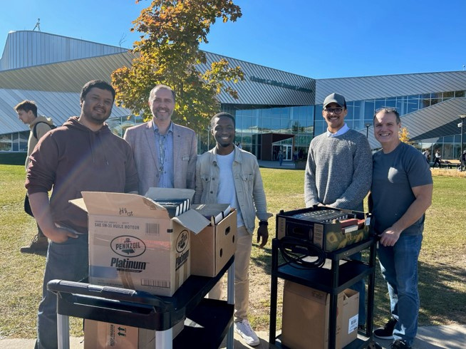


Campus Connections

Slide 2

Campus Ministry at Algonquin College provides pastoral care, spiritual support, and practical assistance to students and staff navigating uncertainty.
Notes:
For many young adults, post-secondary education extends beyond studying and getting through exams. It’s a pivotal time when they’ll figure out who they are, what they believe, and what they hope their future will look like. Campus Ministry at Algonquin College in Ottawa, ON provides a place for students and staff to explore those questions and find support along the way.
Campus Ministry is an ecumenical chaplaincy serving approximately 20,000 students and staff. Since 1993, it has offered pastoral care, spiritual counselling, workshops, and opportunities to explore faith in a safe and non-judgmental environment.
Our Mission and Service gifts help make this ministry possible.
Since 2006, our gifts through Mission and Service have helped support a part-time campus minister. Yuriy Derkach has served in the role since 2011, providing pastoral care and spiritual counselling throughout the year.
Campus Ministry has responded to some significant needs in the Algonquin community. Following Russia’s invasion of Ukraine in 2022, the ministry provided support to international students from Ukraine, Russia, and Belarus, as well as Ukrainians arriving in Ottawa on temporary visas. This included connecting people with language courses and helping them find support with housing, employment, and education.
The ministry also offers practical care during particularly stressful times. At the end of each fall and winter semester, “Pause Break” tables are set up in the Student Commons. In partnership with local congregations, including United Churches, Campus Ministry provides free refreshments and encouragement to students during final assessment week.
That presence is especially important now. Like many post-secondary institutions, Algonquin College has faced program and staffing cuts in response to declining international enrolment. Students are concerned about losing program options, while staff face uncertainty about their jobs. As overall anxiety increases, more members of the college community are seeking support from Campus Ministry.
The impact of this ministry also continues long after students leave campus. A former student recently wrote to express gratitude for the prayers and encouragement they received from Campus Ministry years ago, sharing that the support helped them find their vocation, their life partner, and a church community where they continue to grow in faith.
Our gifts to Mission and Service help make this ministry possible. They allow us to be present in the lives of young adults as they navigate questions of faith, relationships, education, work, and their future.
Together, our gifts help create communities of care, welcome, and hope. Let’s give generously.

