Slide 1
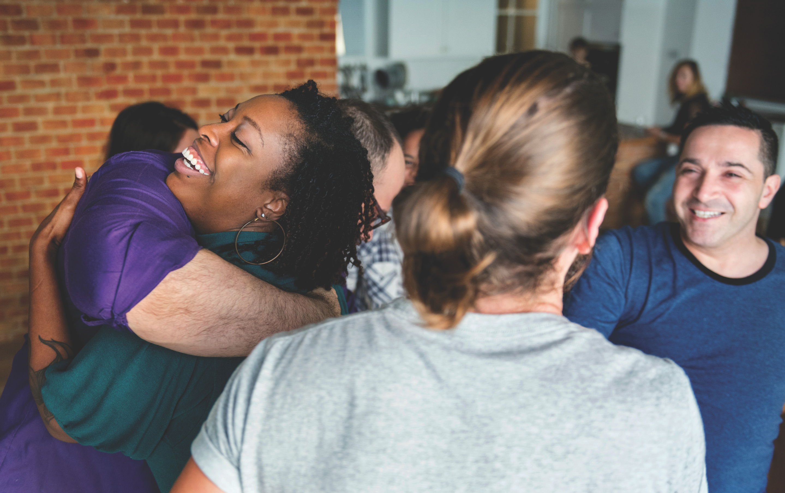


“Come in, come in and sit down”
Food is important, but it’s the fellowship that truly nourishes.

Slide 2
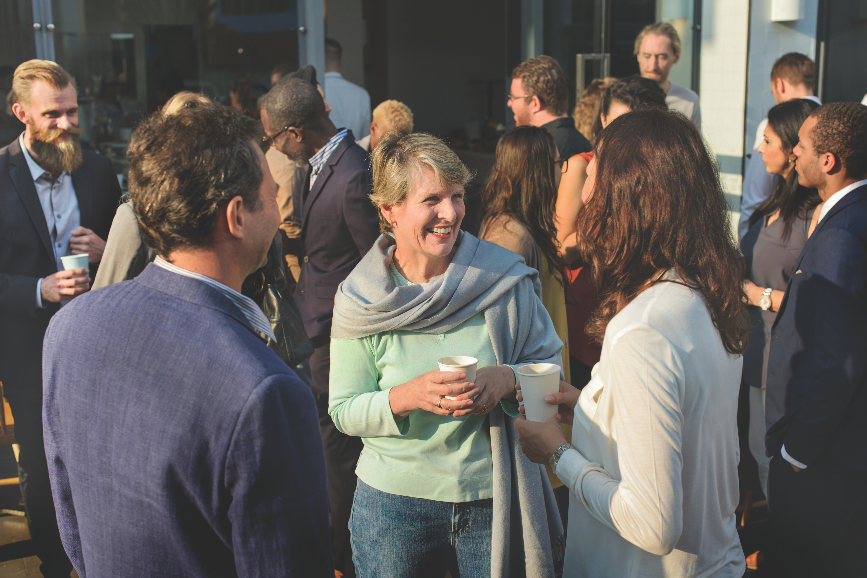
We experience God’s love and abundance by sharing it with others.
Mission and Service is a way to support initiatives that reflect the spirit of gathering and sharing community.

Slide 3
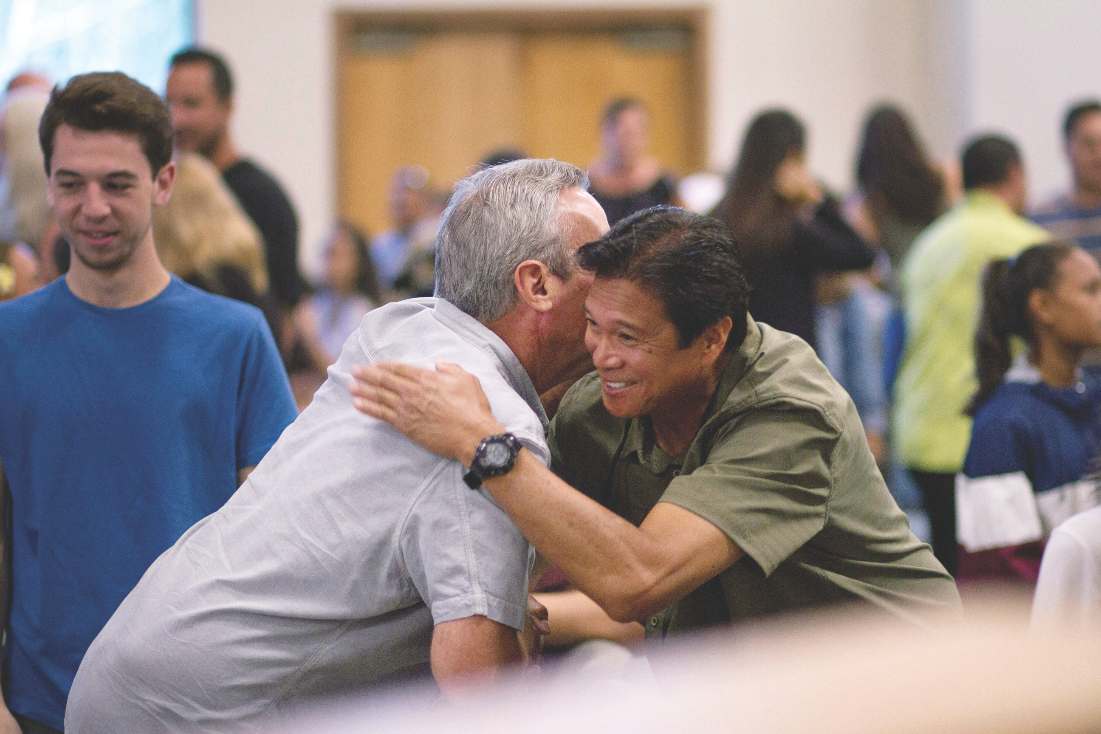
This Thanksgiving,
let’s live who we are.
Give today to share the abundance of fellowship.

Slide 4
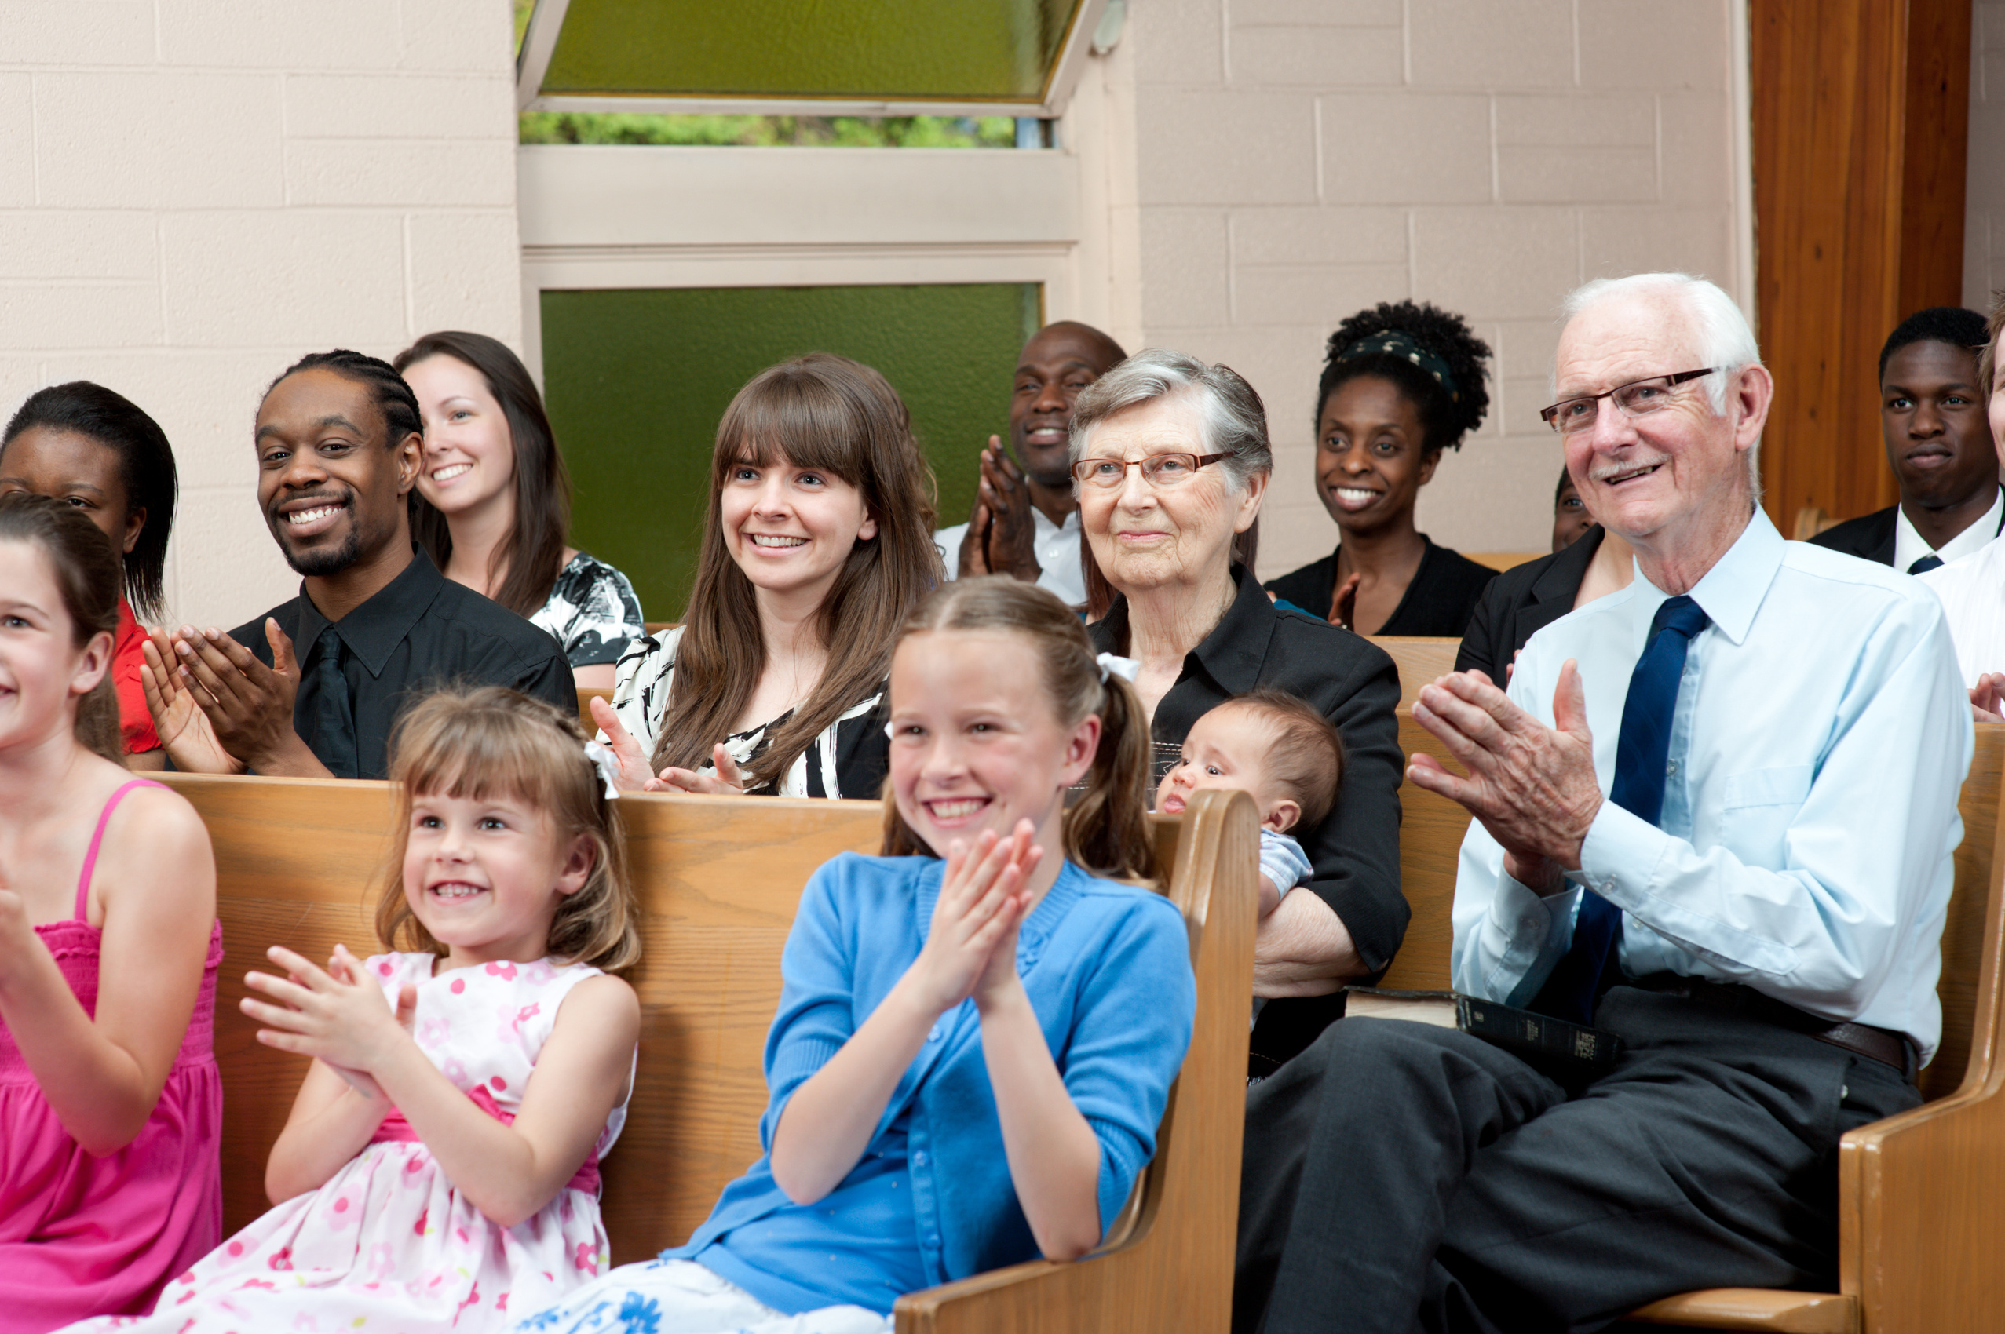
Make a gift to Mission and Service this Thanksgiving
unitedchurchfoundation.ca/thanksgiving
1-800-465-3771

