Slide 1
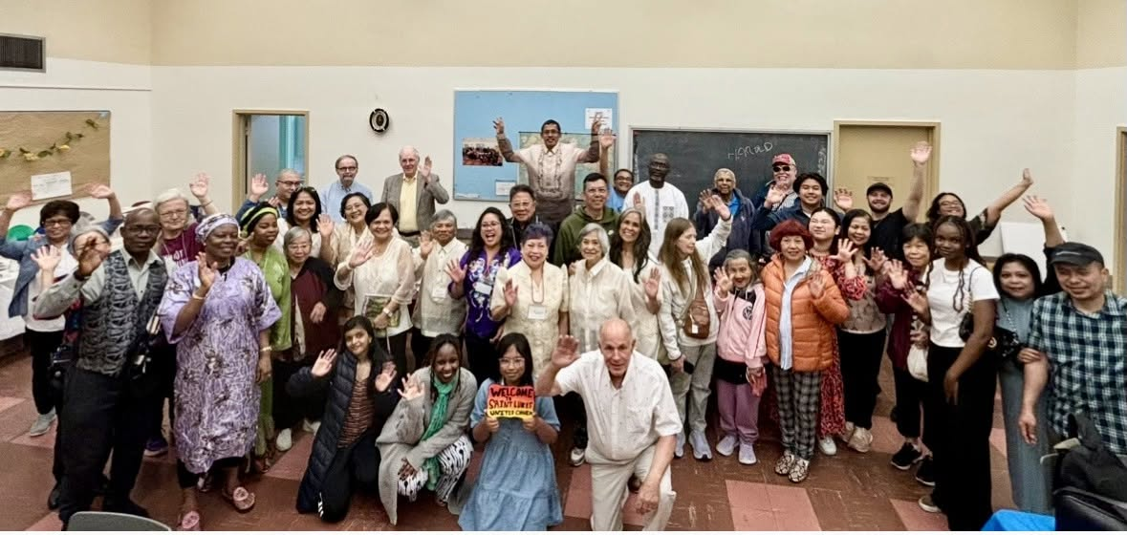


The House of Friendship

Slide 2

At St. Luke’s United Chuch, a strong sense of belonging for newcomers is being expressed through intentional welcome, shared meals, and community.
Notes:
The congregation at Saint Luke's United Church in Toronto, ON understands that belonging rarely happens by accident. It grows through deeply intentional acts of welcome that are joyfully offered to every single person.
Arriving in Canada is only the beginning of the journey for many newcomers. While there is relief in finding safety, there’s also the daunting task of building a new life – finding housing and work, learning unfamiliar systems and languages, making new connections, and carrying the weight of experiences that don’t disappear at the border. For some, those experiences include extremely persecution and trauma. Finding a comfortable place to truly and deeply belong, while facing other challenges, can be a long and exhausting process.
Every Sunday, the congregation at St. Luke’s is prepared for someone new to come through the doors. Of course, there are warm greetings, name tags, and introductions. There is also time in the service where people will leave their seats to offer a hug, handshake, and friendly conversation to all.
“Our Passing of the Peace tradition is that early in the service, we get up, and we move around. We're hugging each other, and we're fist bumping, all while our music director is playing music in the background. It's very crowded, as you can imagine, and people are leaning over pews and such. At that point, people who have been introduced as new, our members of the congregation are reaching out to them and welcoming them and quite intentionally. And this also continues at lunchtime.”
After the service, everyone gathers downstairs for what they affectionately call "coffee hour" – a name that hardly captures the generous meal waiting around the tables. People find a full, warm meal awaiting them.
The food is important, but it’s conversation that nourishes the community. Around the table, people who might never have met elsewhere find themselves sharing a meal and learning about one another. A newcomer to Canada sits beside someone who has worshipped at Saint Luke's for decades. Someone rebuilding their life after escaping persecution discovers neighbours who are genuinely interested in their story, without expecting them to tell it all at once.
One newcomer, who had fled severe persecution before coming to Canada, described finding more than a church. They found people who journeyed with them. As they joined groups, celebrated milestones, and continue to build a new life, the congregation is celebrating alongside them. The community at St. Luke’s understands that healing takes time, and trust is built through consistency, kindness, and simply showing up for one another.
This is the ministry of hospitality at Saint Luke's. It’s not just about opening church doors and having a sign, but about opening a community – one where people are known by name, welcomed with care, and reminded that they do not have to face life's next chapter alone.
Through Mission and Service, we help support ministries like Saint Luke's United Church that create spaces of belonging for newcomers and neighbours alike. Together, we are helping to build communities where God's welcome is lived, shared, and experienced every day. Let’s give generously.

