Slide 1
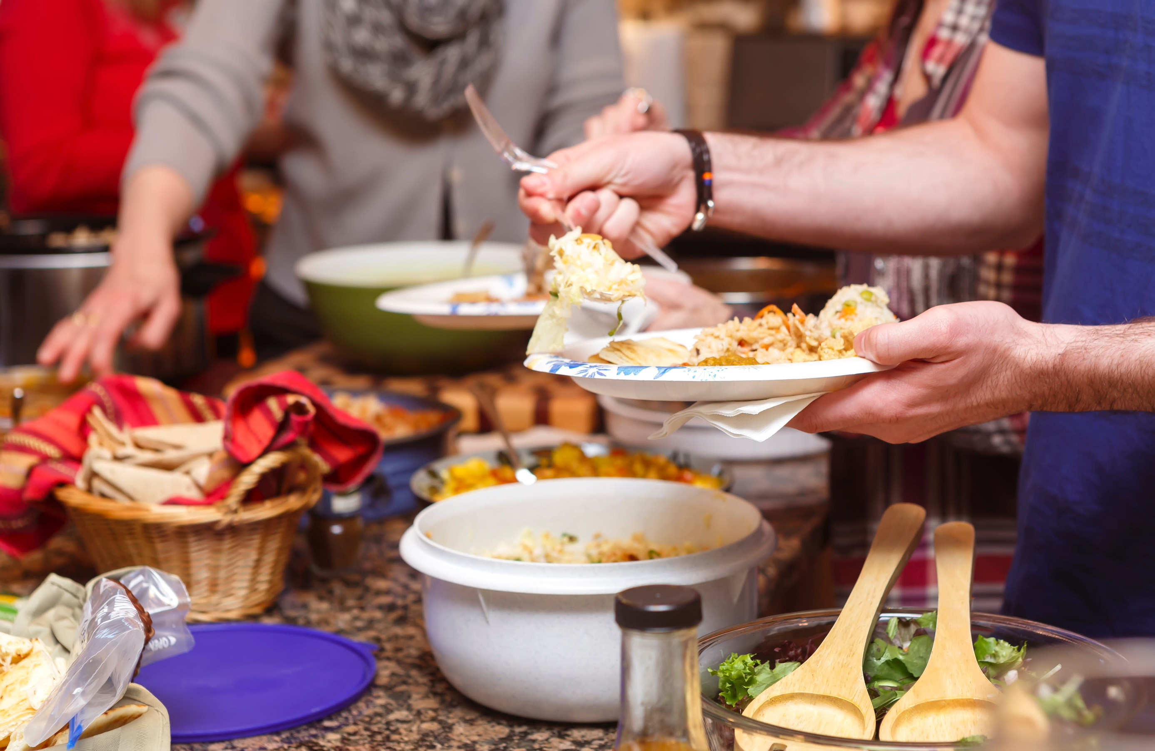


A Place to Turn

Slide 2
Sometimes, the smallest act of kindness can open the door to a new beginning.

