Slide 1
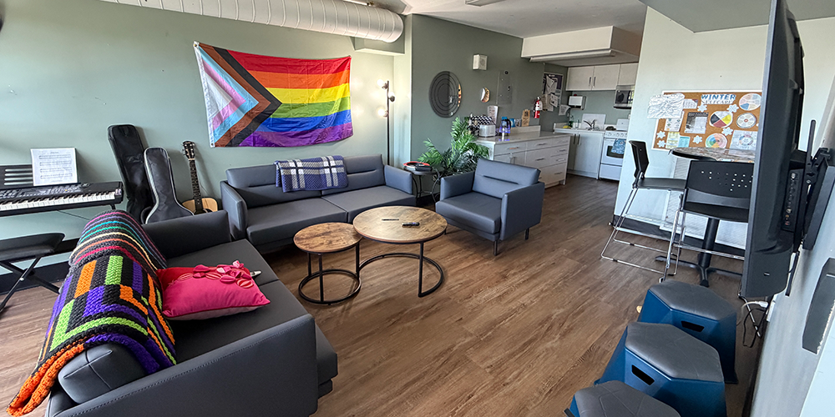


A Stable Start

Slide 2

Wesley Youth Housing offers young people experiencing homelessness the practical support, life skills, and encouragement they need to build independence.

