Slide 1
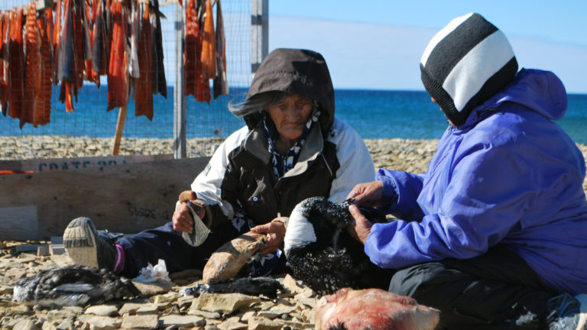


Living Language

Slide 2

The Kitikmeot Heritage Society is providing innovative tools that empower the Inuinnait people to reclaim their language and pass it on to future generations.

