Slide 1
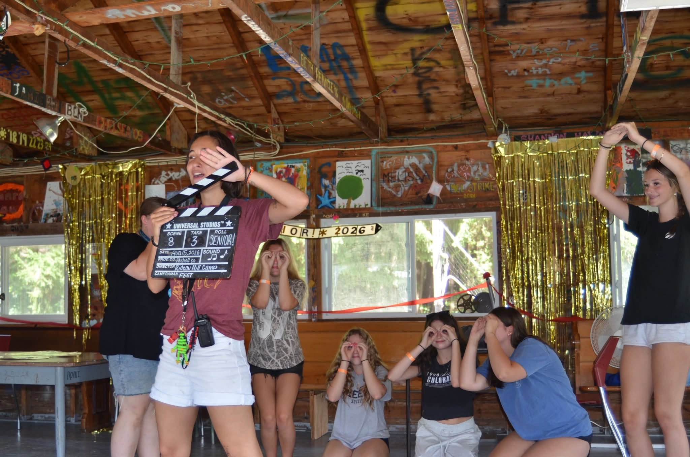


Summertime Memories

Slide 2
Every child deserves the chance to make summer memories, discover new talents, and find a place to belong.

