Slide 1
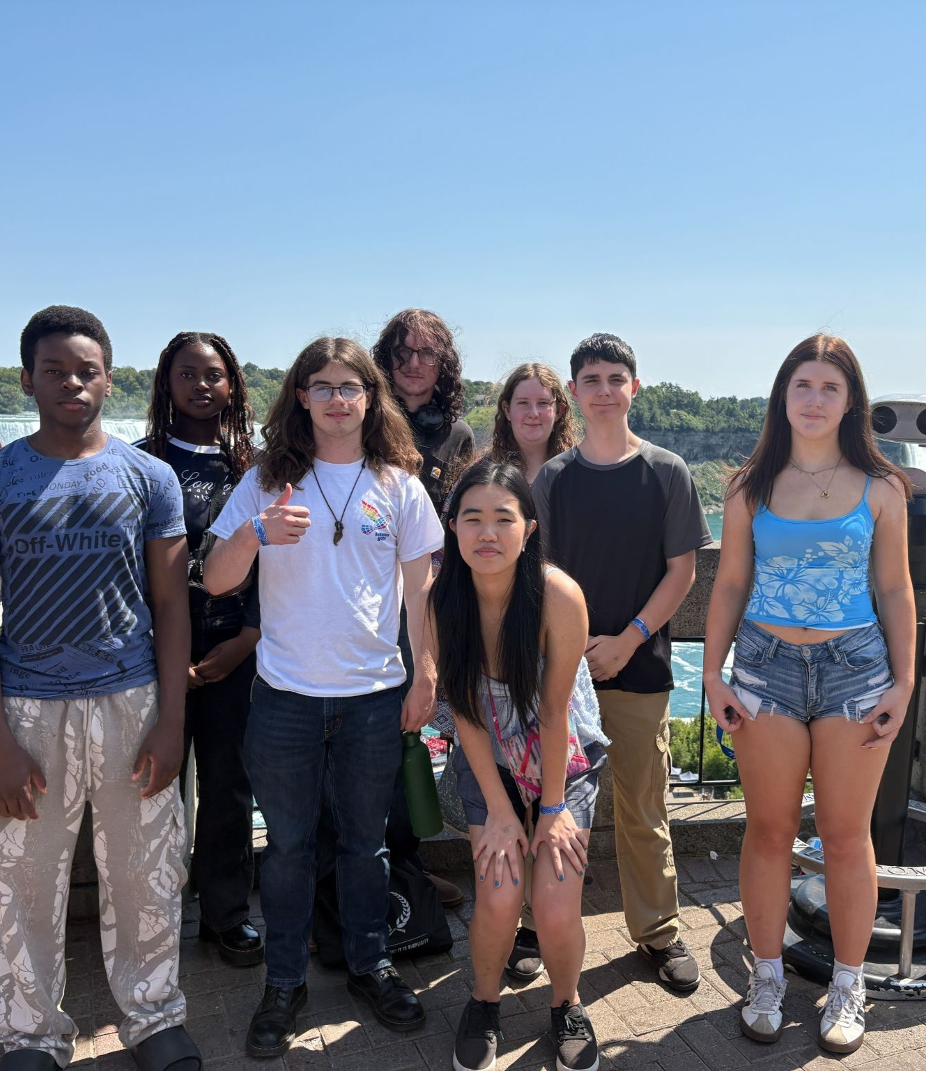


Youth Leadership Animators

Slide 2

What happens when young people are given the chance to lead, grow in faith, and shape the future of the church? The Leadership Animator program explores that very question!

